Slide 1
INTERNAL USE ONLY
January 2022
OCS Seqential Data Store
Instructor: Ken Hart

Slide 2
Working with the SDS API
This course is a 4 hour introduction to the OCS Sequential Data Store (SDS) API. SDS is an API that provides a Database as a Service (DBaaS).
Some of our more practical goals include examining data ingress and egress scenarios using the SDS API.
Clients using SDS will utilize the API to collect and analyze data to make better business decisions.

Slide 3
Learning Objectives
Students will be able to:
Set up one or more tenants
Set up namespaces
Define custom types with both single and compound indices
Define streams
Describe POST, PATCH, DELETE and GET calls to communicate with the SDS API
Use the OCS API Console to make calls to the SDS API
Perform data ingress operations such as populating and modifying a stream
Perform data egress operations to retrieve single and bulk events
Describe how to analyze data to detect trends and anomalies
Use PATCH and DELETE operations to amend data

Slide 4
Tools and Environment
Before arriving for class, students will need:
Access and credentials to OCS
(Helpful) Visual Studio Community 2019 or above

Slide 5
Course Outline
Introduction
Accessing the SDS API via the Console Portal
Data Ingress:
Break
Data Egress
(Not enough time)
OCS .Net Tools
Authentication
OCS NuGet packages
Ingress and egress examples

Slide 6
Introduction
Introducing the course and instructor
Significance of SDS in the historical context of OCS (provided by OSI)
Use cases for SDS

Slide 7
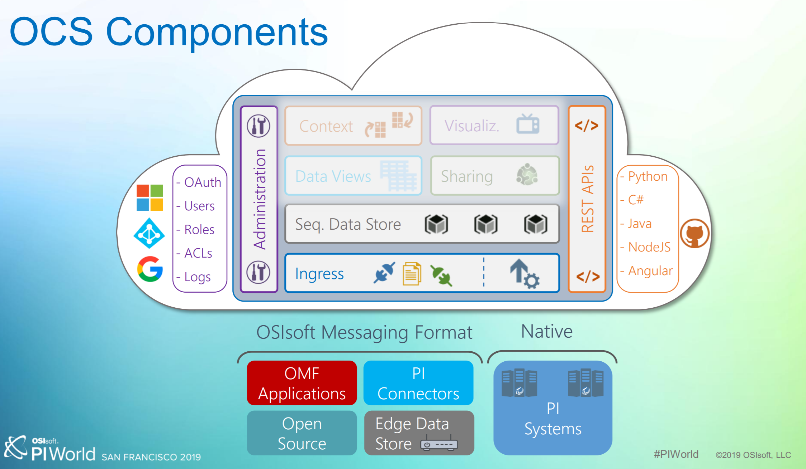
OCS Overview
OSIsoft Cloud Services (OCS) is cloud-based platform that manages data for reporting, advanced analytics, and third-party applications
Provides flexibile, resilient data storage
Supports high-speed, scalable, elastic data ingress
Use modern, secure REST APIs to interact with your data
Built and deployed using Microsoft Azure
OCS is powered Sequential Data Store (SDS)

Slide 8
PI System
PI System is a data historian product that is a critical component in major industries around the world, including the power grid, manufacturing, pharmaceutical, and many more.
With over forty years of successful deployments, it is a time-tested world-class product
In the early 2010s, OSIsoft recognized the coming explosion of data sources and an industry
trend toward Software as a Service (SaaS) deployment models.
Rather than simply host PI Server in the cloud, they decided that a purpose built, cloud native solution would provide the best experience for both existing and future customers.
OSIsoft leveraged their decades worth of experience with data management to create a new historian called SDS, or Sequential Data Store, hat can be deployed from the edge to the cloud
This means customers can capture and intelligently analyze all of their data.

Slide 9
Sequential Data Store (SDS)
SDS is a modern, lightweight and extensible technology stack
It is the backbone of OSIsoft data historians running both on lightweight edge ARM devices, as well as those deployed in distributed environments
It is capable of scaling far beyond what a typical single PI Server could
SDS features include:
additional indexing types (not just time series)
the ability to create compound and secondary indexes
integrated search and data filtering
Customers get the data they need fast.

Slide 10

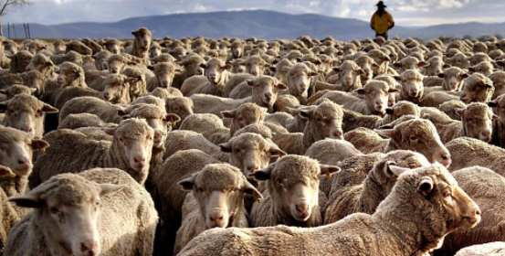


SDS Use Case
The first telephone, first aircraft and first PC were all considered interesting novelties when first created
Few anticipated the huge economic and socialogical impact they would have in shaping the future
If modern ranchers could monitor and store massive arcane bits of data about sheep grazing in fields:
their hour-by-hour location and steps
climate conditions (rain, wind direction and speed and temperature)
How would gigabytes of this type time-series data be useful?
We’ll see in the following clip some exciting possibilities of real-world applications of SDS in ranching

Slide 11

Film Clip: AgTech

Slide 12
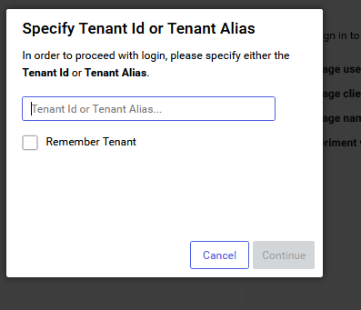
Setting Up the Course Environment With the OCS Dashboard
Authenticate Using Your Tenant Credentials

Slide 13
Tenants
A tenant represents the set of services, applications, data, and configuration state available to a customer
Users are associated with a tenant via at least one configured identity provider
A user's access to resources is managed via the assignment of roles
The role defines have permissions for the stream (ex: read, write, delete)

Slide 14
Namespaces
A namespace is a logical unit of organization for data within a tenant
It is a collection of types, streams, and stream views
When you create a stream, you assign it to a namespace
Before you can add data to a given tenant, you must create a namespace
Namespaces must have an identifier
Rules include:
no more than 100 characters
comprised only of alphanumeric characters, underscores, dashes, spaces, and periods
cannot start with two consecutive underscores
cannot start or end with a period
cannot have two consecutive periods
Each tenant may contain more than one namespace
Namespace identifiers are unique within an account
Each namespace is effectively an instance of SDS, within which you create types and streams, stream views, data views, and metadata.

Slide 15
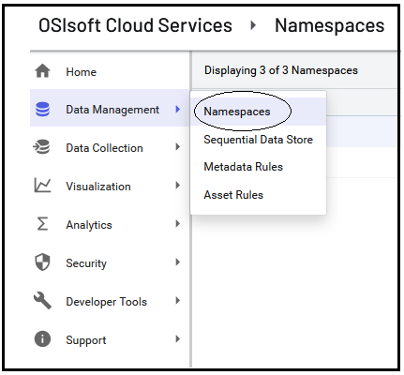
Setting Up a Namespace With the OCS Dashboard
https://ocsadminstaging.osipi.com/tenant/[tenant id] /dashboard
replace the [tenant id] placeholder with your tenant id
add a namespace, if necessary

Slide 16
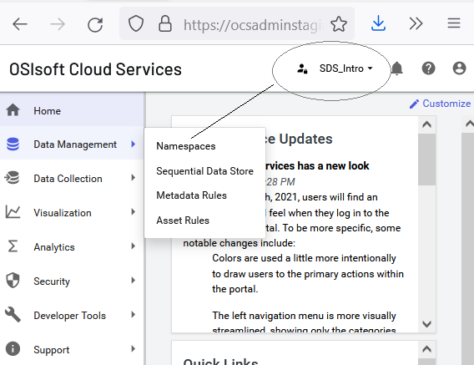
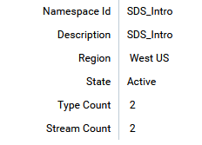
Create a Namespace for Course Use
To have your code match slides and labs, use SDS_Intro as your namespace
Once created, you can select the active namespace in the upper right of the dashboard page

Slide 17
Communities (informational only, no action required)
OCS Communities allows industrial companies to share their operational data with external business partners, service providers, and analytics providers.
OCS tenants can perform the following actions with Communities:
• Share data with external partners without bringing their users inside the corporate firewall or taking
extra security precautions.
• Share data without requiring external users to be onsite.
• Share data with external partners who do not have a PI System or other required software.
Share data with a partner
The process for creating a community consists of:
1. Creating a community.
2. Invite another OCS tenant to join the community.
3. Add users from your own tenant to the community.
4. Add clients for programmatic access to the community.
5. Share streams with the community.

Slide 18
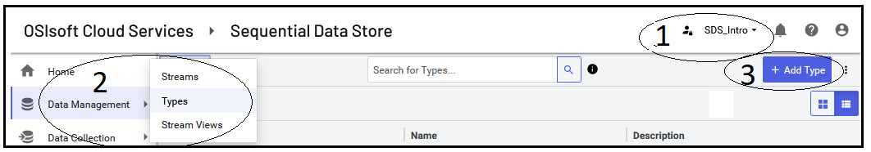
Setting up: Add a Type
1. Use dropdown on top right to select a namespace
2. Click dropdown the left and change to ‘Types’
3. Click the Add Type button on the right

Slide 19
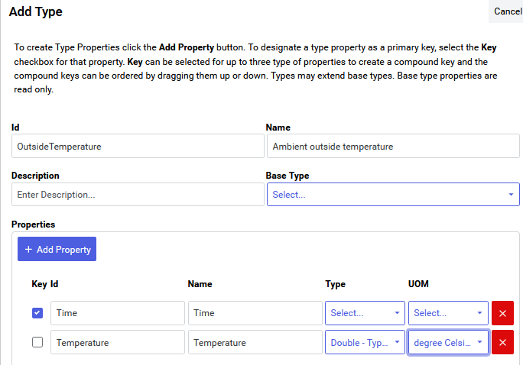
Define a Simple Type Now for Outside Temp in °C
An SDS type defines the structure of a piece of data or information about an event
Types can be simple or complex
Simple types might be:
longitude
latitude
heading
pressure
temperature
rainfall
stepcount

Slide 20
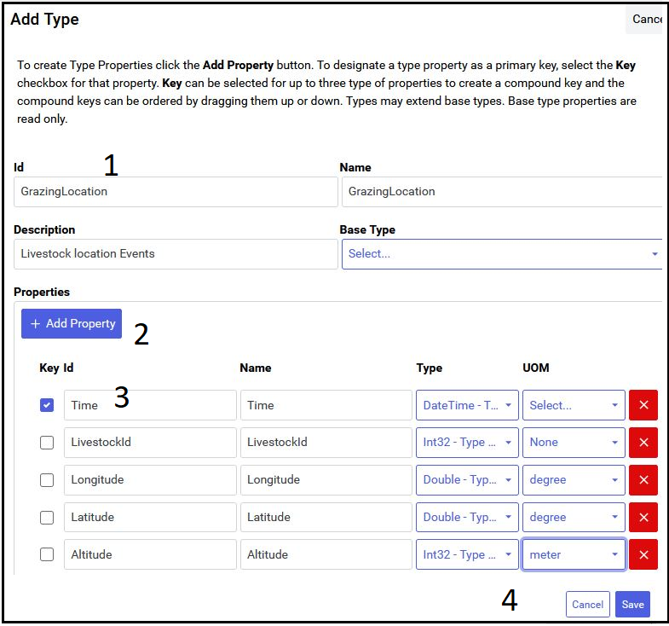
Define a Complex Type
add name/metadata
Add type properties
add property details
Save

Slide 21
Type Details
Key (checkbox)
An SDS type must have at least 1 property marked as key
this makes it an index property
indexes may be single or composite
Id
unique string identifier
Name
friendly name (default value is same as Id)
Type
system atomic types or pre-defined tenant types
UOM (Unit of Measure)
read-only metadata designation
for example: pressure might be:
Int-32 with a uom of millibars
double with a uom of psi
double with a uom of hectopascals

Slide 22
Type Id Details
1. Is not case sensitive
2. Cannot just be whitespace
3. Cannot contain leading or trailing whitespace
leading/trailing spaces cause difficult-to-diagnose errors
4. Cannot contain forward slash ("/")
5. Can contain a maximum of 100 characters

Slide 23
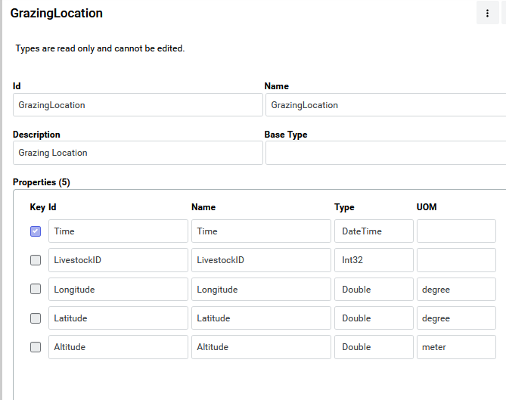
Example: Grazing Livestock
Once created, types are read-only
At the present time, to edit, you must delete then re-define the type

Slide 24
Editing a Type
Strictly speaking, this isn’t allowed
A type must be deleted, then a new one created with the desired changes
Creating a type is reasonably fast programmaticaly or via the daskboard
A work-around is to use the API-Console, Postman or simlar tool, as follows:
retrieve the type definition (/Namespaces/[namespaceId]/Types/[TypeId])
do a GET request using the above URI
edit the JSON payload, as desired
perform a POST with the modified JSON

Slide 25
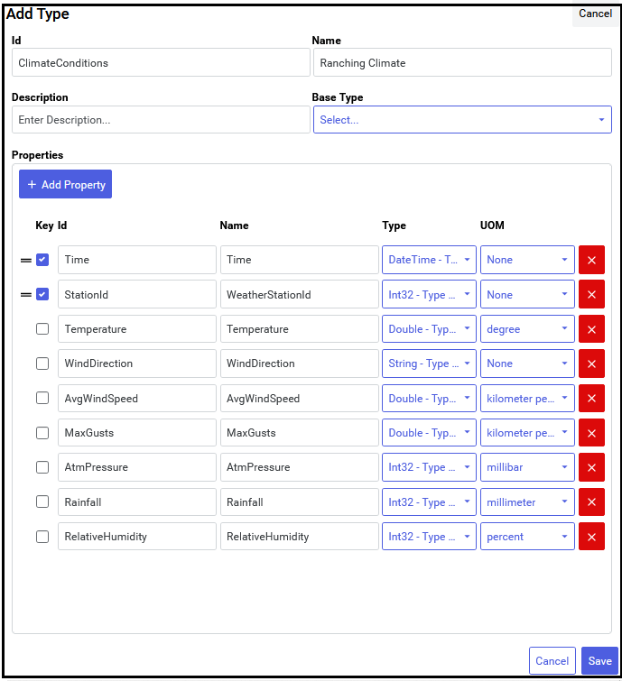
Exercise: Create a ClimateType
Composite index consisting of Time and WeatherStationid (DateTime and Int32, respectively)
Temperature is double: °C
WindDirection is a 16-point compass direction (string) N, NNE, NE, ENE, E, ESE, SE…
AvgWindSpeed is double: km/s
MaxGusts is double: km/s
AtmPressure is Int32: millibars
Rainfall is Int32: millimeters
RelativeHumidity is Int32: Percent

Slide 26
Exercise: Create a GrazingLocation Type
Create the type, as shown
View the types in the dashboard
Also, view in API Console
/[namespaceId]/types
View the detailed type info as JSON

Slide 27
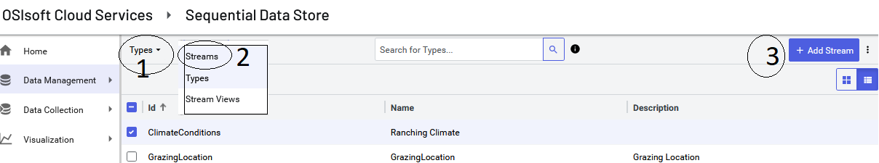
Creating Streams
1. Click the left dropdown
2. Select ‘Streams’
3. Click the right button to add a new stream

Slide 28
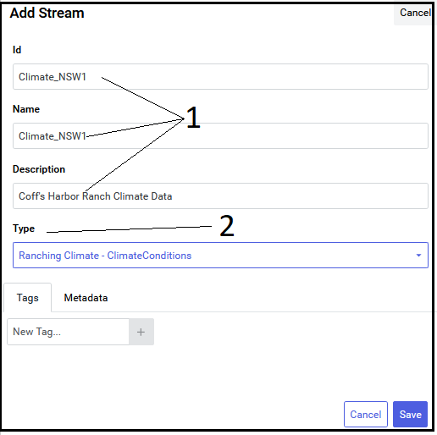
Stream Creation Follow-Along
1. Add appropriate id,name, description info
2. Choose a type for the stream (use the climate type created previously)

Slide 29
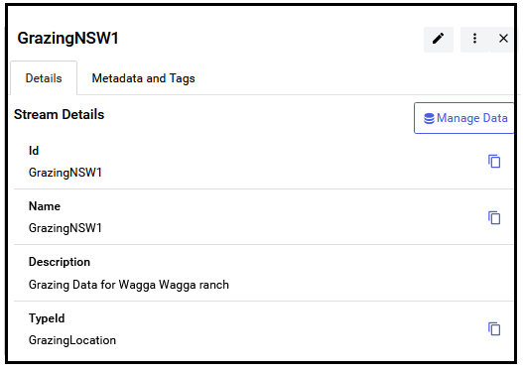
Create a Second Stream Using the GrazingLocation Type
Once the stream is created, a “Manage Data” button will be displayed
Use to view existing data or add new events

Slide 30
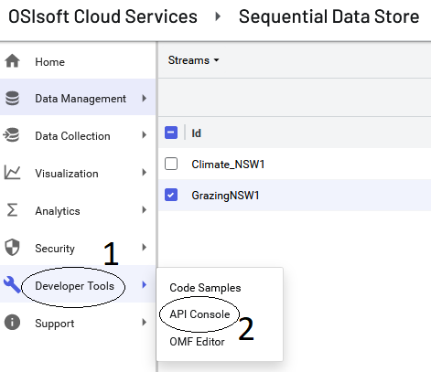
Using the API Console
Since there’s probably no existing stream data at this point, we’ll need to add some sample data
1. Select Developer Tools
2. Select API Console

Slide 31
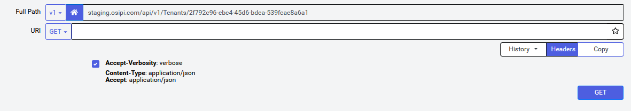
API Console Introduction
Full Path
Displays the full URI to execute
the ‘home’ icon toggles between the base URI and the base plus the tenant entry-point
URI
Details to add to the base URI
‘/Namespaces’ is the default

Slide 32
Follow-Along: Testing the API Console
With the default setting of ‘Tenant Path Enabled’ (the home button)
Enter ‘/Namespaces’ as the URI
Note: the full path includes the base tenant path plus the URI
Note: HTTP request headers are read-only in the API for some URI’s
Specifiying headers using a tool such as Postman may have no effect if the API doesn’t use the headers
For example, Accept-Language, Accept, Content-Type and Cookie may be ignored by the server
application/xml and audio/mpeg are probably irrelevant for Accept and content negotiation and thus would be ignored
Accept-Language as arabic-tunisia (ar-tn) or Spanish-Costa Rica (es-cr) are probably irrelevant at this time
The the API console by searching for a list of namespaces

Slide 33
API Console: Display Types and Streams
Test the following URI’s
/Namespaces/[namespaceid]/Types
/Namespaces/[namespaceid]/Streams
and
/Namespaces/[namespaceid]/Types/[typeid]
/Namespaces/[namespaceid]/Streams/[streamid]
/Namespaces/[namespaceid]/Streams/[streamid]/data example: /Namespaces/SDS_Intro/Streams/GrazingNSW1/data

Slide 34
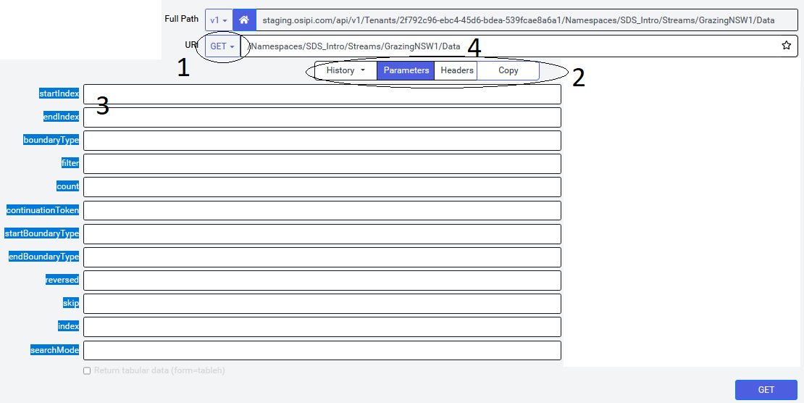
API Console…cont’d
1. Request Method (GET, PUT, POST, PATCH, DELETE)
2. History: re-run queries Parameters: query params Headers Copy the URI
3. Enter desired parameters
4. The resulting query
Since there’s no data yet, We’re not ready to test

Slide 35
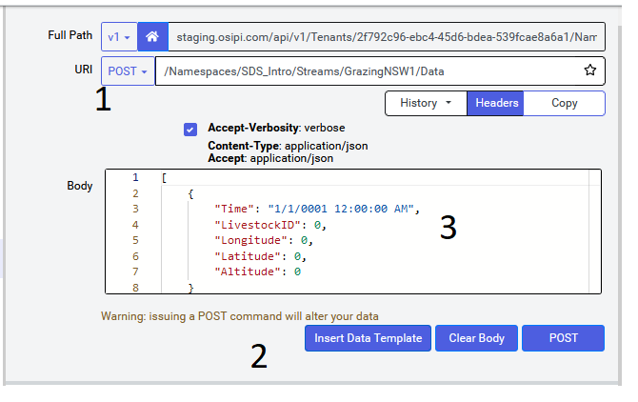
Add data
1. Change URI type to POST
2. Click “Insert Data Template”
3. Accept the default data or modify
4. Press ‘enter’ or click POST button (lower-right)
5. Test by changing URI type back to ‘GET’
6. Modify the URI text to
/Namespaces/SDS_Intro/Streams/GrazingNSW1/Data/First
7. Other options
leave out the /First and add an Index of your posted data
0001-01-01T00:00:00Z (default beginning of calendar time)
If you use StartIndex, you can include an EndIndex or a Count to pick up a range

Slide 36
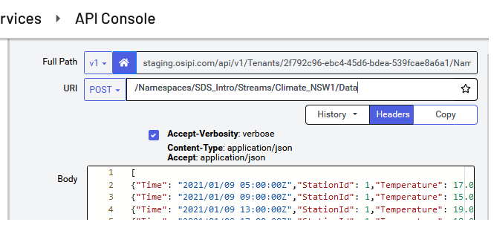
Adding Bulk Data
Open the provided file “JsonClimateData.txt” in your text editor (notepad or similar)
Copy and paste the file contents into the cleared Body of the request (see screenshot)
URI is POST and /Namespaces/SDS_Intro/Streams/GrazingNSW1/Data
if your streamId is different than GrazingNSW1, then change the URI accordingly
Click POST

Slide 37
Insert Bulk Grazing Data
Repeat the last exercsise with the GrazingNSW1 stream and using JSON data from GrazingData.txt
After successfully posting new data, re-run the same request
Confirm an error
What does the following message suggest is the cause of the error?
Status Code: 409 Text: Client Error
"OperationId": "204ebd6c5a2dff4aaeadc8731bce8235",
"Error": "The request was unsuccessful due to a conflict.",
"Reason": "A value already exists at the specified index.",
"StreamId": "GrazingNSW1",
"Index": "2021-09-02T05:00:00.0000000Z"

Slide 38
Follow-Along: Other Ingress Operations
Instructor will lead in performing POST, DELETE, PATCH operations

Slide 39
More Advanced Egress Examples

